Slide 1
Exponents
Grade 8

Slide 2
An exponent is a mathematical notation that represents how many times a base is multiplied by itself. Other terms used to define exponents are ‘power’ or ‘index’. An exponential term is a term that can be expressed as a base raised to an exponent. For example, in an exponential expression a^{n}, 'a' is the base and ‘n' is the exponent.
The exponents can be numbers or constants; they can also be variables. Exponents are generally positive real numbers, but they can also be negative numbers.

Slide 3
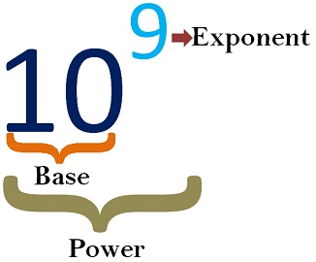

Slide 5
Examples

Slide 6
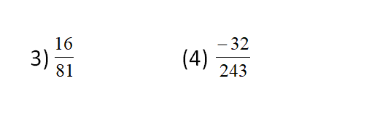

Slide 7
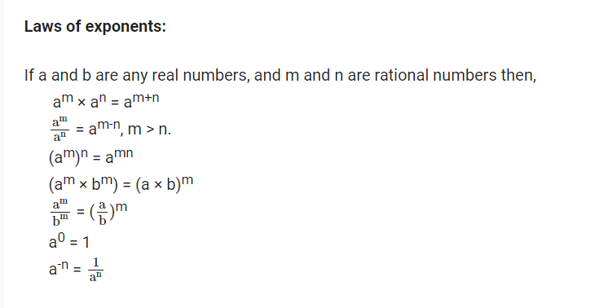

Slide 8
Law 1
1. How to multiply powers with the same base?
If we have to multiply the powers which have the same base then we have to add the exponents.
a^{m} × a^{n} = a^{m + n}
Example
8³ × 8⁴ = 8³ ⁺ ⁴ = 8⁷

Slide 9
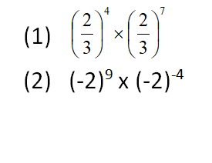

Slide 10
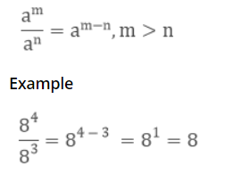
Law 2
2. How to divide powers with the same base?
If we have to divide the powers which have the same base then we have to subtract the exponents.

Slide 11
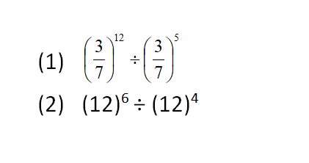

Slide 12
Law 3
3. How to take the power of a power?
If we have to take the power of a power then we have to multiply the exponents.
(a^{m})^{n} = a^{mn}
Example
(8³)⁴ = 8^{3 × 4} = 8¹²

Slide 13
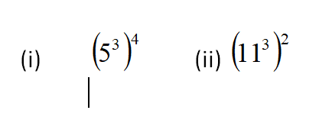

Slide 14
Law 4
4. How to multiply the powers with the same exponents?
If we have to multiply the powers where the base is different but exponents are same then we will multiply the base.
a^{m} b^{m} = (ab)^{m}
Example
8³4³ = (8× 4)³ = 32³

Slide 15
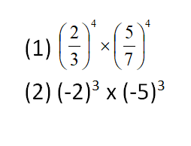

Slide 16
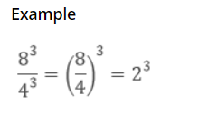
Law 5
5. How to divide the powers with the same exponents?
If we have to divide the powers where the base is different but exponents are same then we will divide the base.

Slide 17
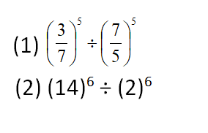

Slide 18
Law 6
6. Numbers with Exponent Zero
Any number with zero exponents is equal to one irrespective of the base.
a° = 1
Example
8° = 1

Slide 19
Law 7
7. Numbers with Exponent One
Any number with one as the exponent is equal to the number itself.
a¹ = a
Example
8¹ = 8

Slide 20
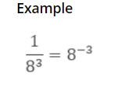
Law 8
8. Power with a Negative Exponent
Negative exponents can be converted into positive exponents.

Slide 21
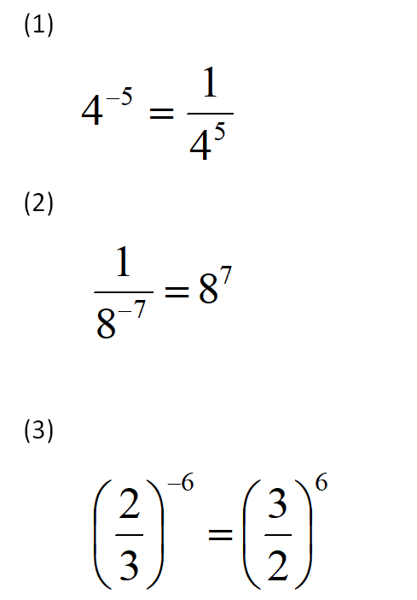

Slide 22
Thank You

